Slide 1
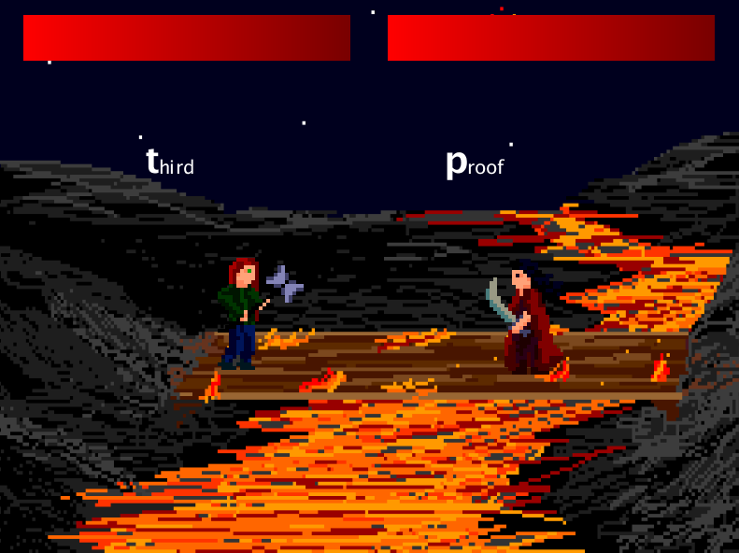
Twister-Fighter
by Ben Greenberg, Nathan Arce, Mike Salvato, Alex Goins, Todd Layton, and Beth Findley

Slide 2

Code Synthesis
Utilized github very effectively
Wrote descriptive comments on additions
Did not use github’s branching to fullest of capabilities, some disorganization

Slide 3
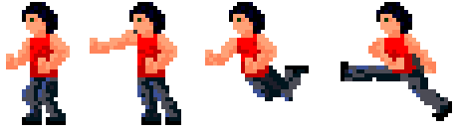
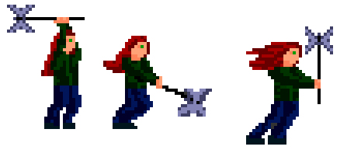
Animation
Biggest challenge
Added effects later in game
Very simplistic animations
Characters still don’t really matter to player

Slide 4

Playtesting
Opened our eyes to many problems in game
changed around basic layout
almost added movement
words not letters

Slide 5
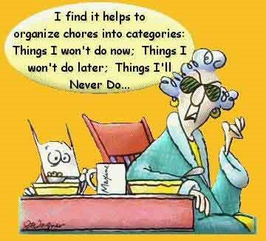
Organization
Overall very organized
No party chat
git issue tracker
email galore
No project manager

Slide 6
Hind Sight
Assign project manager first day
Start playtesting earlier if possible
Utilize git’s branching capabilities

